Slide 1

A Detailed Comparison of Cloud vs On-Premises IT Infrastructure
Key Differences and Benefits

Slide 2
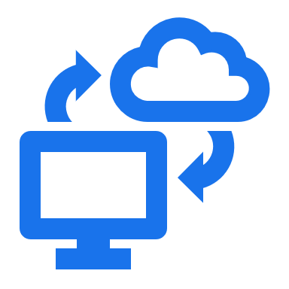
Cloud Infrastructure
Cloud infrastructure allows businesses to consume IT resources (compute, storage, networking, databases) without owning or managing physical hardware.
Instead, cloud providers (AWS, Azure, GCP) handle:
Deployment – Buying, installing, and configuring infrastructure.
Management – Updating, troubleshooting, and optimizing performance.
Security & Compliance – Implementing encryption, IAM, and regulatory frameworks.

Slide 3

As a Service (aas)
"Deployed + Managed" as a Service:
When IT infrastructure or software is "deployed and managed" as a service, it means that a third-party provider (such as AWS, Azure, or Google Cloud) is responsible for:
Deployment – Setting up and configuring the service.
Management – Handling updates, maintenance, security, and troubleshooting.
This model allows businesses to consume IT resources on demand without worrying about infrastructure setup and maintenance.

Slide 4
On-Premises IT Infrastructure
On-premises computing refers to IT infrastructure that is hosted, managed, and maintained within an organization's own data center.
The company is responsible for everything, including hardware, software, networking, security, and upgrades.
Key Advantages:
Full Control – Complete authority over data, security, and configurations.
Customization – Tailored infrastructure for specific business needs.
Compliance & Security – Essential for regulated industries (e.g., finance, healthcare).

Slide 5
On-premises vs Cloud Infrastructure
On-Premises
Cloud Infrastructure
Managed by cloud providers (AWS, Azure, GCP)
Pay-as-you-go (OPEX)
Highly scalable; resources can be added or removed instantly
Managed security with compliance and built-in security features
Cloud provider manages updates and infrastructure
Minutes to hours (provisioning resources in the cloud)
Cloud providers offer built-in backup, redundancy, and failover solutions
Fully owned and managed by the company
High upfront costs (CAPEX)
Limited scalability; requires purchasing and setting up new hardware
Fully controlled by the organization
IT team handles updates, security, and troubleshooting
Weeks to months (buying hardware, setup, and configuration)
Requires setting up backups and DR sites

